Slide 1
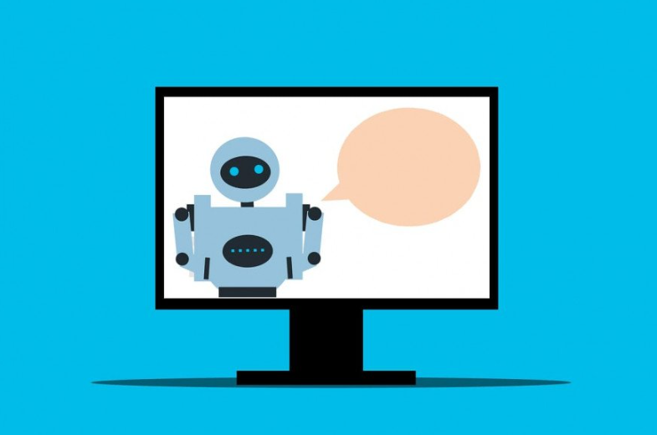
What do you need to create a simple AI?

Slide 2
Steps to design an AI system
Identify the problem.
A programming language
AI libraries and frameworks
Gather and preprocess data
Choose the algorithm
Hardware
Model training
Model tuning
Time and Expertise
how to train ai model to identify images, voice , text , video ,etc

Slide 3
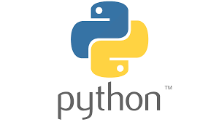


Programming language
Python is a popular language for AI and machine learning due to its simplicity, readability, and vast array of open-source libraries and frameworks such as TensorFlow, Keras, and PyTorch.
Java: Java is widely used language in business applications.
C++: C++ is a fast and efficient language used in game development

Slide 4
Gather and preprocess data
Data: You will need a large and diverse dataset to train your AI model effectively. will need a dataset that represents the task or problem you want the AI to solve.
you will need to gather data that the AI program will use to learn and make predictions. For a simple program, you can use existing datasets that are available online, such as the MNIST dataset for recognizing handwritten digits. You may also need to preprocess the data to ensure that it is in a usable format.
Notes:
Preprocessing data

Slide 5
What is Preprocessing data
1.Data cleaning: removing or correcting data that is missing, duplicated, or incorrect.
2.Feature selection: selecting the most relevant features that will have the most impact on the model's performance.
3.Data transformation: transforming data into a different format or structure that can be better understood by the model or algorithm.
4The purpose of preprocessing data is to improve the quality and accuracy of the data used to train a machine learning model.
Notes:
selecting the most relevant features-သက်ဆိုင်ရာအင်္ဂါရပ်များကို ရွေးချယ်ခြင်း။

Slide 6
Choose the algorithm
Depending on the problem, you may need to choose a specific AI approach, such as simple machine learning algorithms like k-Nearest Neighbor or Decision Trees. Select the right approach based on the problem you want to solve.
Some common machine learning algorithms include:
Supervised Learning
Unsupervised Learning
Reinforcement Learning

Slide 7
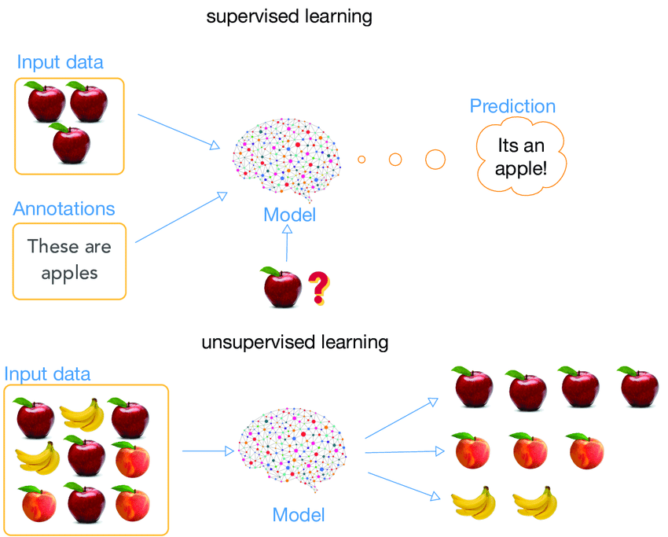

Slide 8
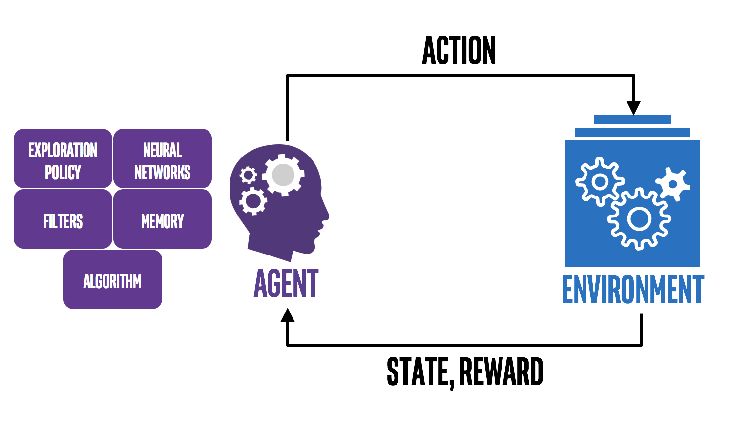
Reinforcement Learning

Slide 9
AI libraries and frameworks
TensorFlow: Developed by Google, TensorFlow is an open-source library used for numerical computation, machine learning, and deep learning. It is used for building and training neural networks.
PyTorch: Developed by Facebook, PyTorch is an open-source machine learning library used for building and training deep neural networks. It is popular for its dynamic computational graph feature.
Scikit-learn: Scikit-learn is a Python library used for machine learning tasks such as classification, regression, and clustering. It includes tools for data preprocessing, model selection, and performance evaluation.
Keras: Keras is a high-level API for building and training deep learning models. It provides a user-friendly interface and can run on top of TensorFlow or other backends.
Notes:
regression, and clustering-

Slide 10

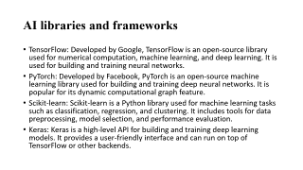
Hardware
Hardware: You will need a powerful computer or server to train and run your AI model.
Notes:
Hardware: Depending on the size of the dataset and complexity of the AI model, you may need access to high-performance computing resources such as GPUs or TPUs to speed up the training process.
GPUs-graphics processing units
TPUs-Tensor Processing Units

Slide 11
Model Training
An AI model refers to a specific type of artificial intelligence that has been trained on a dataset to perform a specific task
Model training:During training, the model will learn to recognize patterns and features in the data.
AI model training is the process of teaching an artificial intelligence model to perform a specific task or make accurate predictions by presenting it with a set of input data and corresponding output labels.

Slide 12
Model Tuning
Model tuning: If the model is not performing well enough, you may need to tune its parameters or change the model architecture.
Model selection: Choose an appropriate model architecture for the task at hand. For example, for text classification, you may use a recurrent neural network (RNN), while for voice recognition, you may use a convolutional neural network (CNN)

Slide 13
Time and Expertise
"Time" and "Expertise" refer to two important resources that are required to successfully develop and deploy AI applications.
1."Time" refers to the amount of time it takes to complete each stage of the AI development process, from data preparation and model building to deployment and maintenance.
Developing and training AI models can be a time-consuming process, especially when working with large datasets or complex models.
2."Expertise" refers to the specialized knowledge and skills required to design, build, and deploy AI applications.
Having access to sufficient time and expertise can help ensure that AI projects are completed on time, on budget, and with high-quality results.

Slide 14
How to train ai model to identify images, voice , text , video ,etc
Convolutional Neural Networks (CNNs) are a popular type of neural network used for image recognition, object detection, and other computer vision tasks. Here are the steps to use CNN in Python:
First, you need to install the required libraries such as TensorFlow, Keras, and NumPy. You can do this by using pip, a package manager for Python.
need to load the data set you want to train the CNN on. You can use the Keras library to load common data sets such as MNIST or CIFAR-10.
Train Model:You can use the fit() method in Keras to train the model.
Evaluate Model:You can use the evaluate() method in Keras to evaluate the accuracy of the model.
Make Predictions:You can use the predict() method in Keras to make predictions on new images.

Slide 15

&
Any Question!

